Slide 1

Building a Thriving UK Neurotechnology Ecosystem
Dr Luke Bashford, PhD

Slide 2


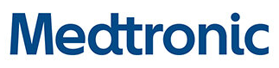

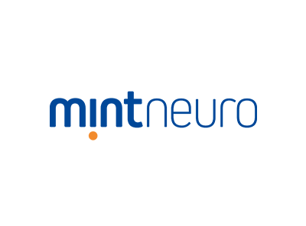
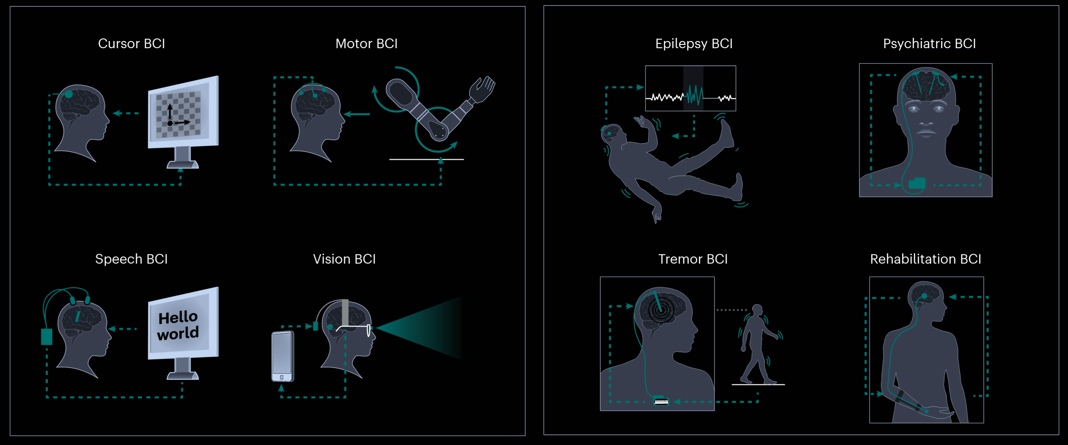

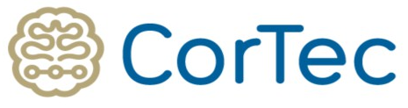

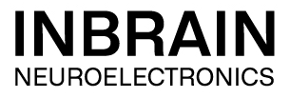



What is Neurotechnology
Neurological disorders are now ranked as the leading cause of overall disease burden worldwide.

Slide 3
UK Strengths
Strong research and innovation in engineering and basic neuroscience.
A significant cluster of specialist institutes
The NHS to be world leading infrastructure for research and development in neurotechnology.
Highly engaged regulatory body.

Slide 4
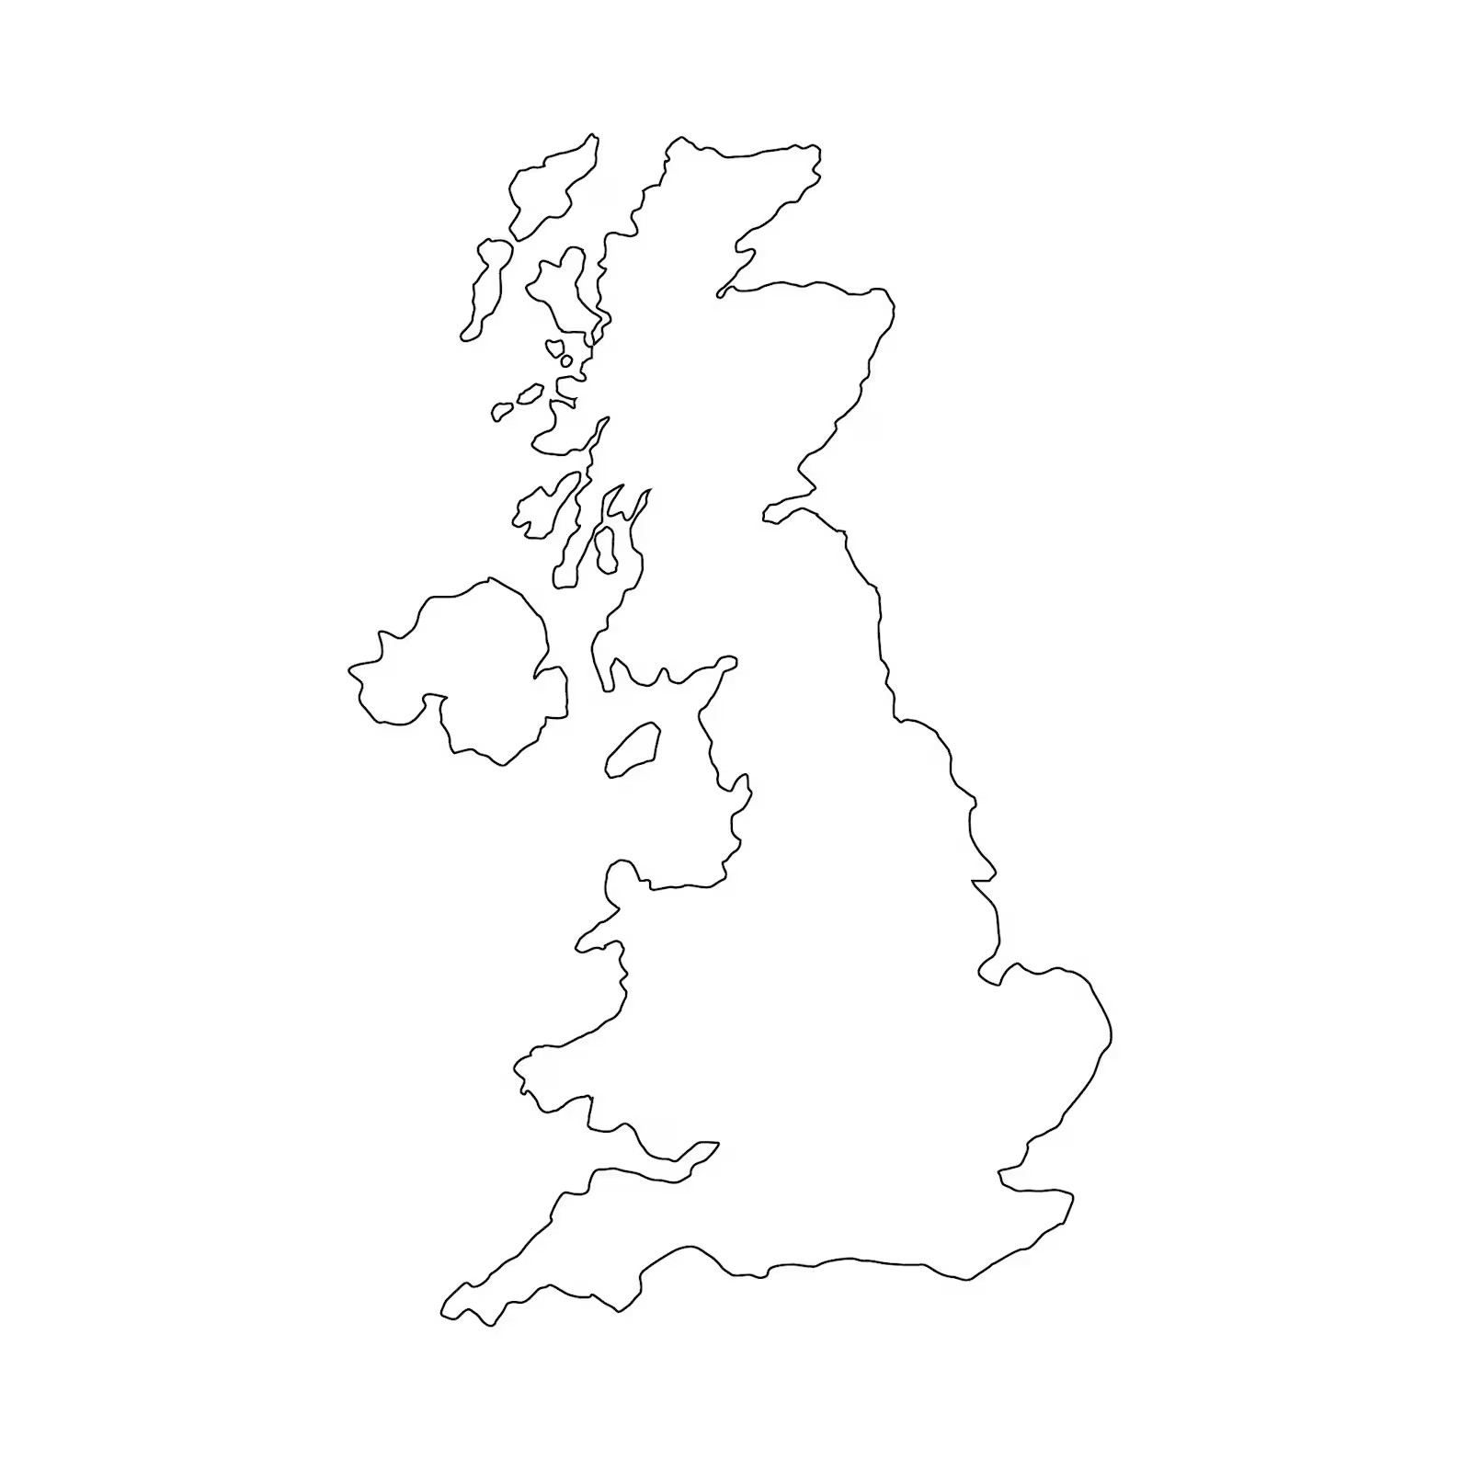







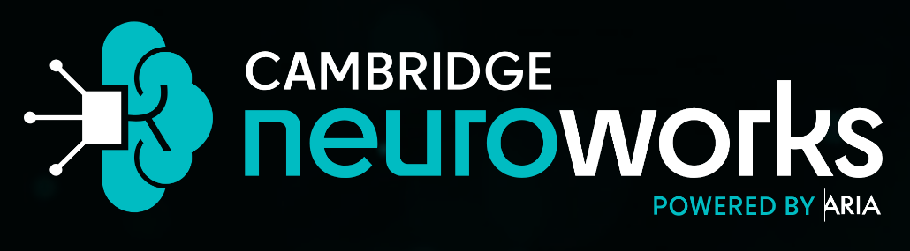



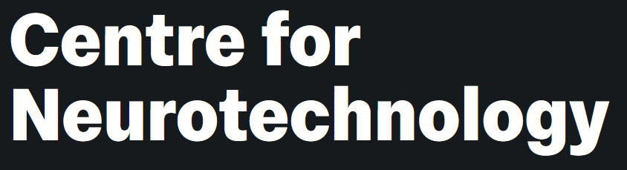

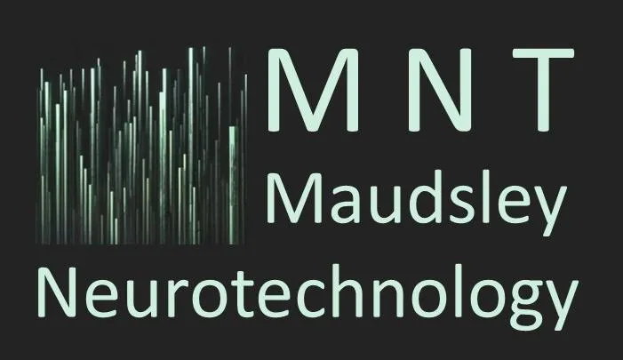
UK Strengths

Slide 5
UK Weaknesses
Clinical translation to commercialisation infrastructure
Limited public funding for long-term device research
Perceived and actual complexity in regulatory processes, especially at research/first-in-human stages

Slide 6
The opportunity
The UK is positioned as a global leader in the development and deployment of neurotechnology
From building experimental research in clinical settings to broader societal use
  Transformative clinical benefit
  Significant economic benefit
  Global partnerships
Critical leadership areas:
  The NHS as a global platform for the research and development of neurotechnologies and a living laboratory throughout peoples' lifetimes.
  Development of neural data privacy, ownership, ethical adoption and governance structures.

Slide 7
Dr. Galen Buckwalter

Slide 8
Justine Knowlson

Slide 9

Before Implant

Slide 10
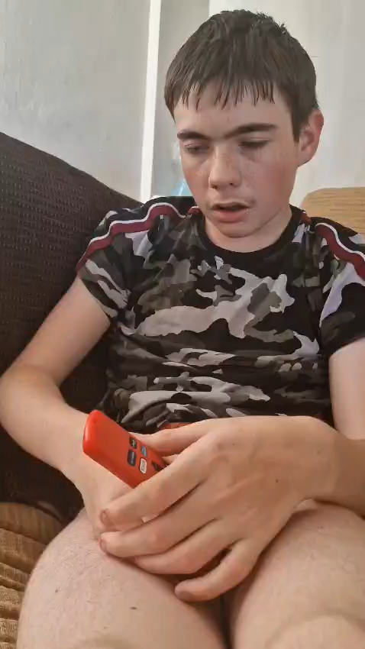
Before Implant

Slide 11
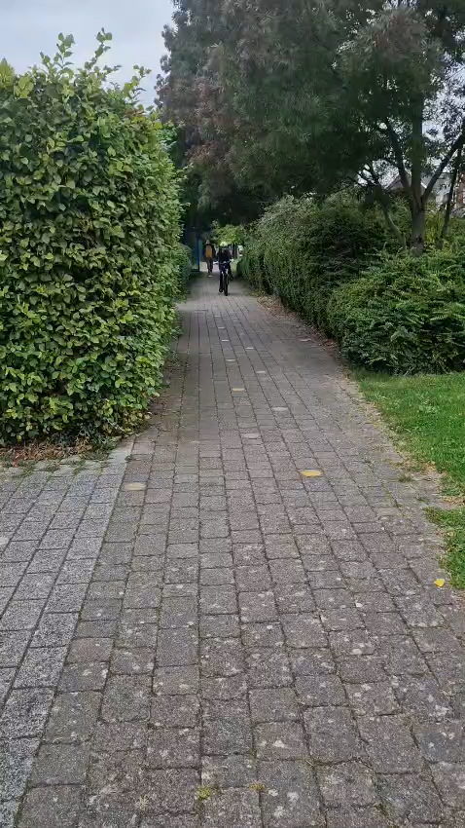
After Implant

Slide 12

After Implant

Slide 13
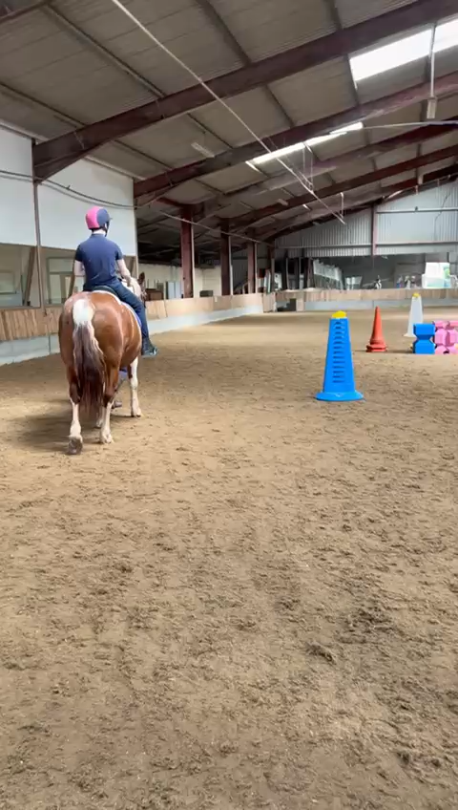
After Implant

Slide 14
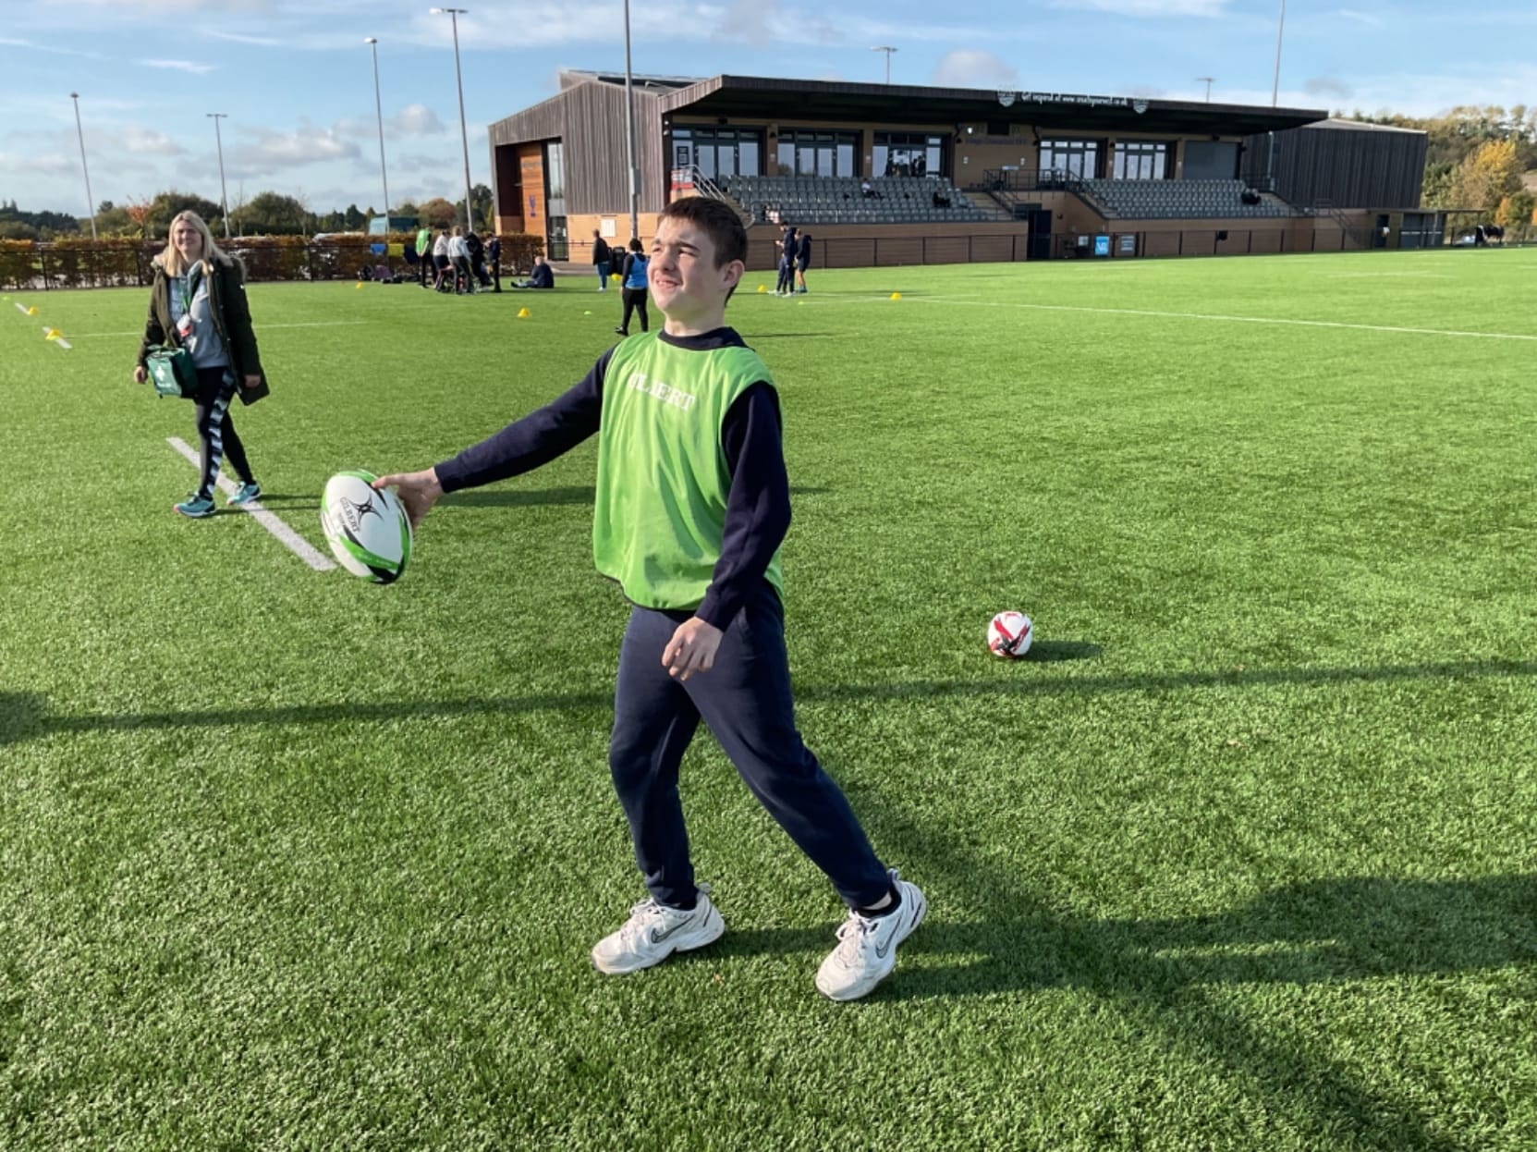
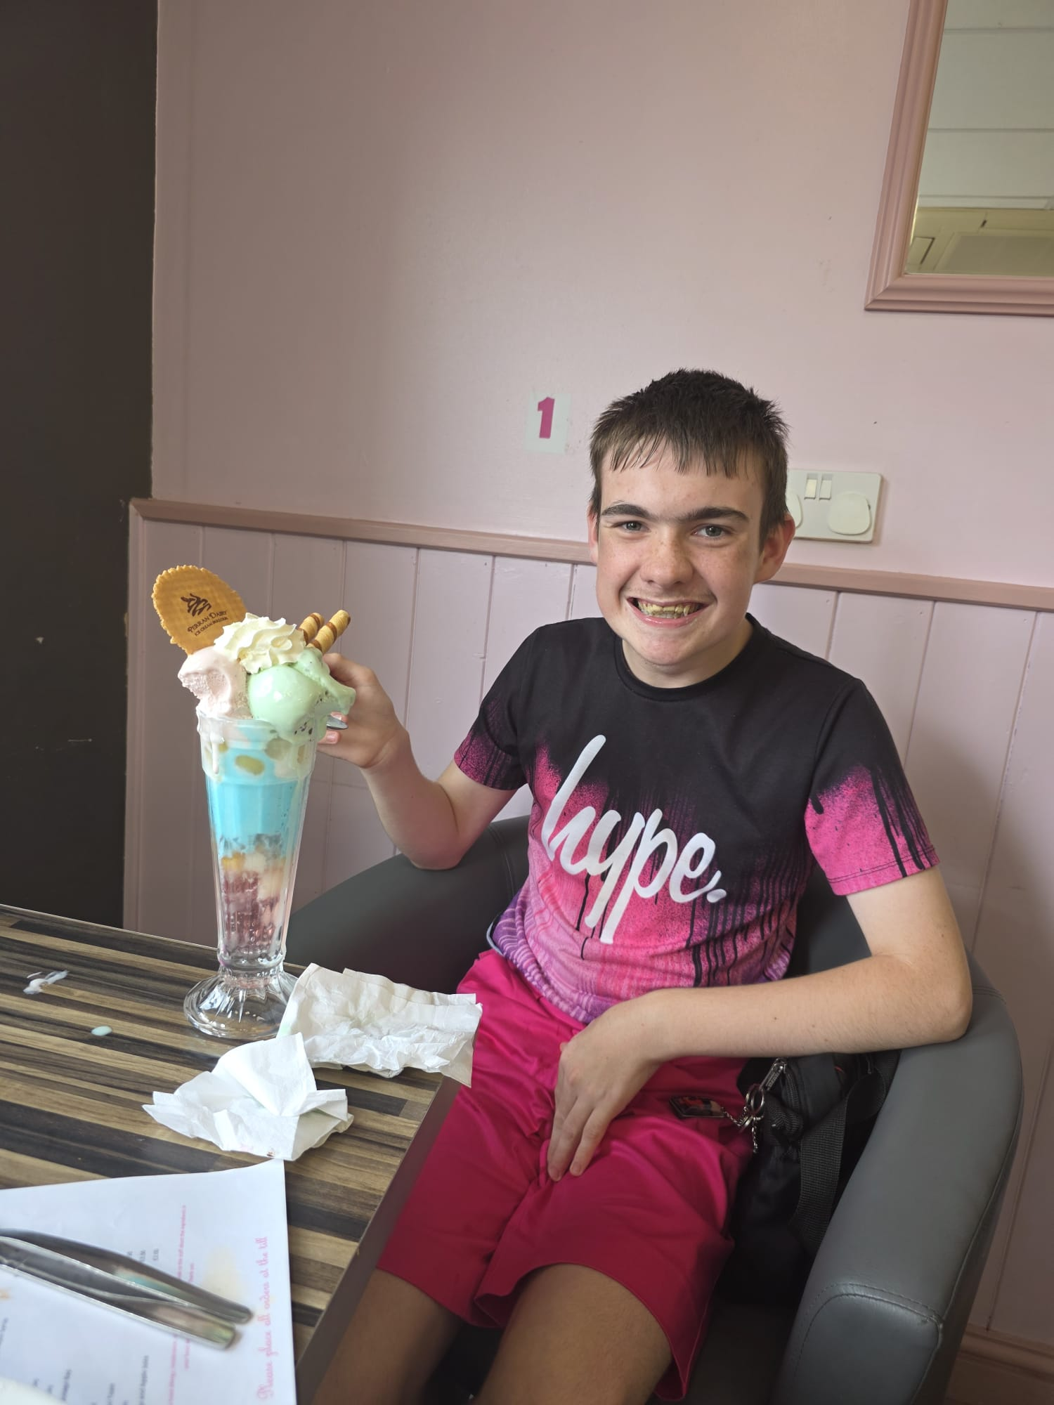
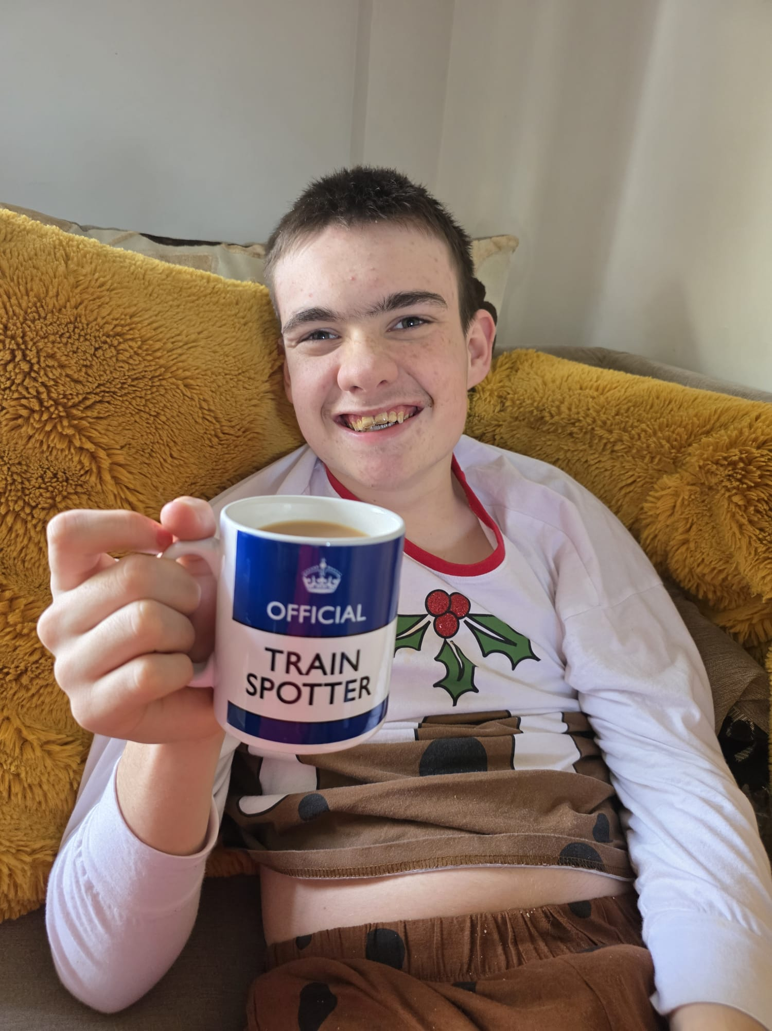
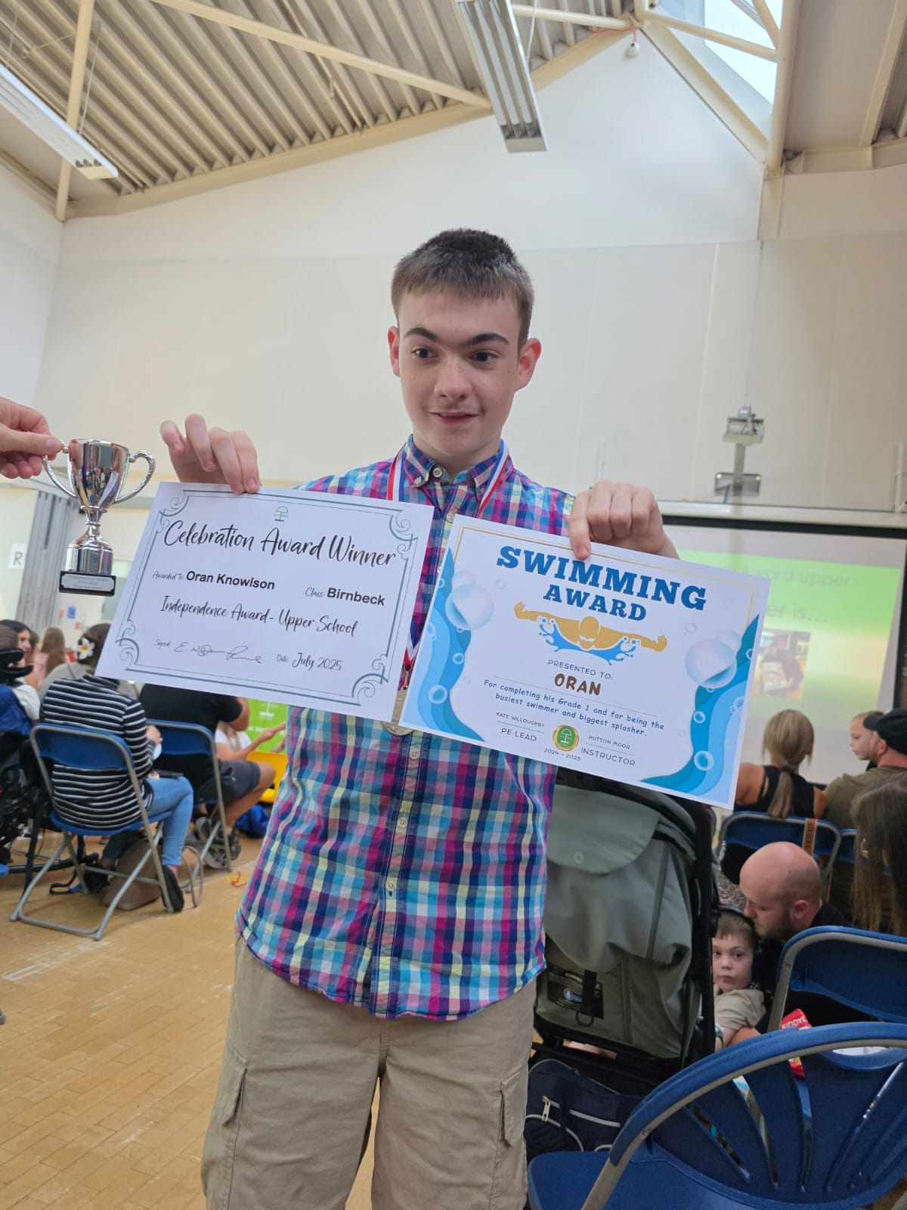
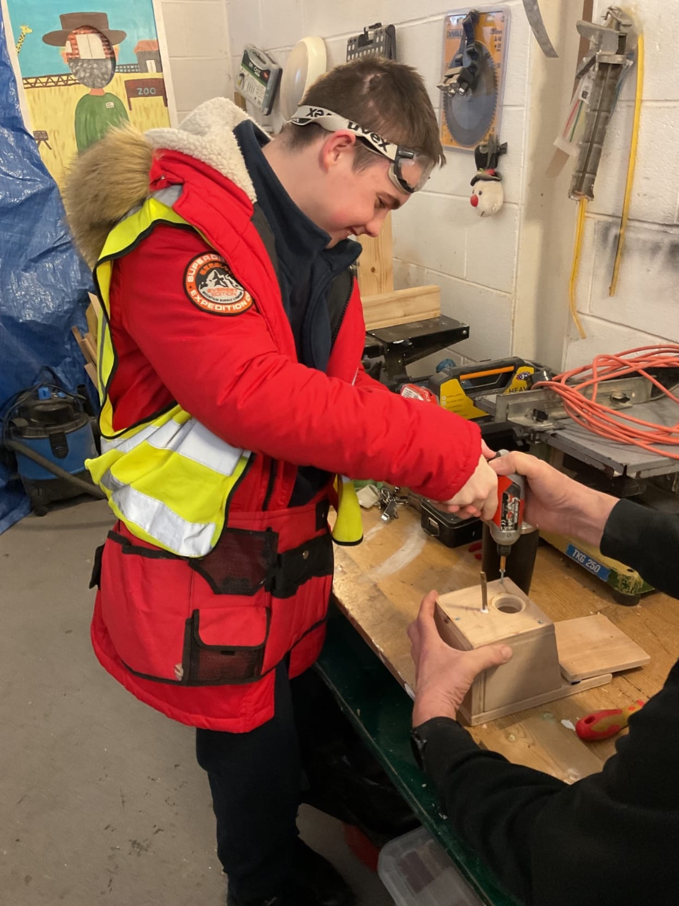
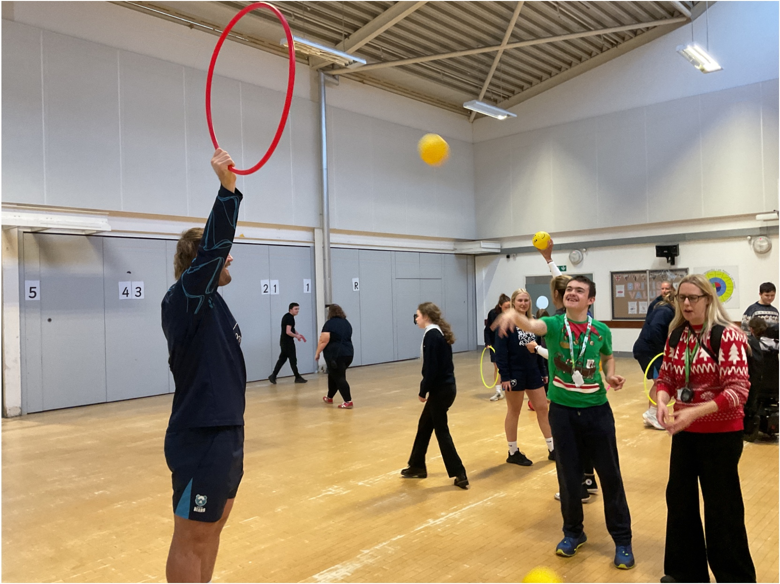

Slide 15

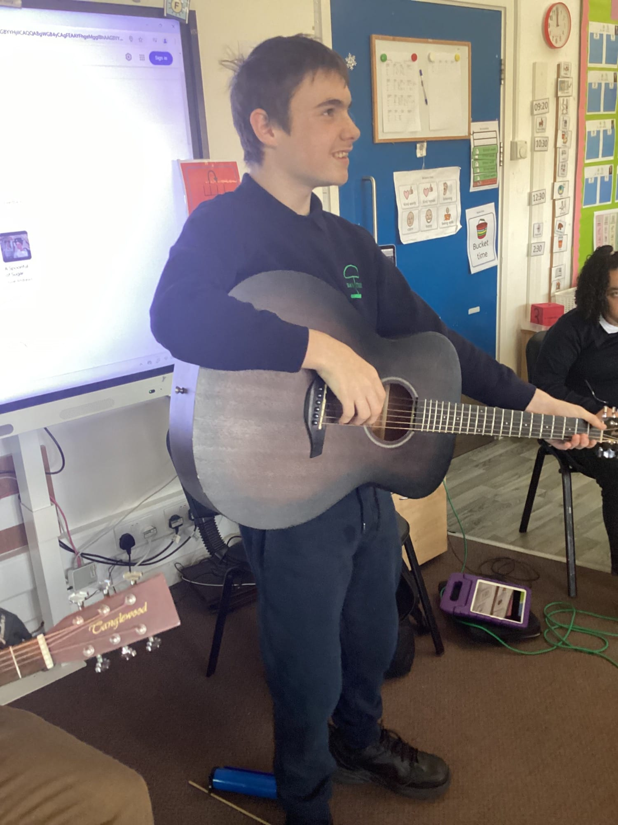
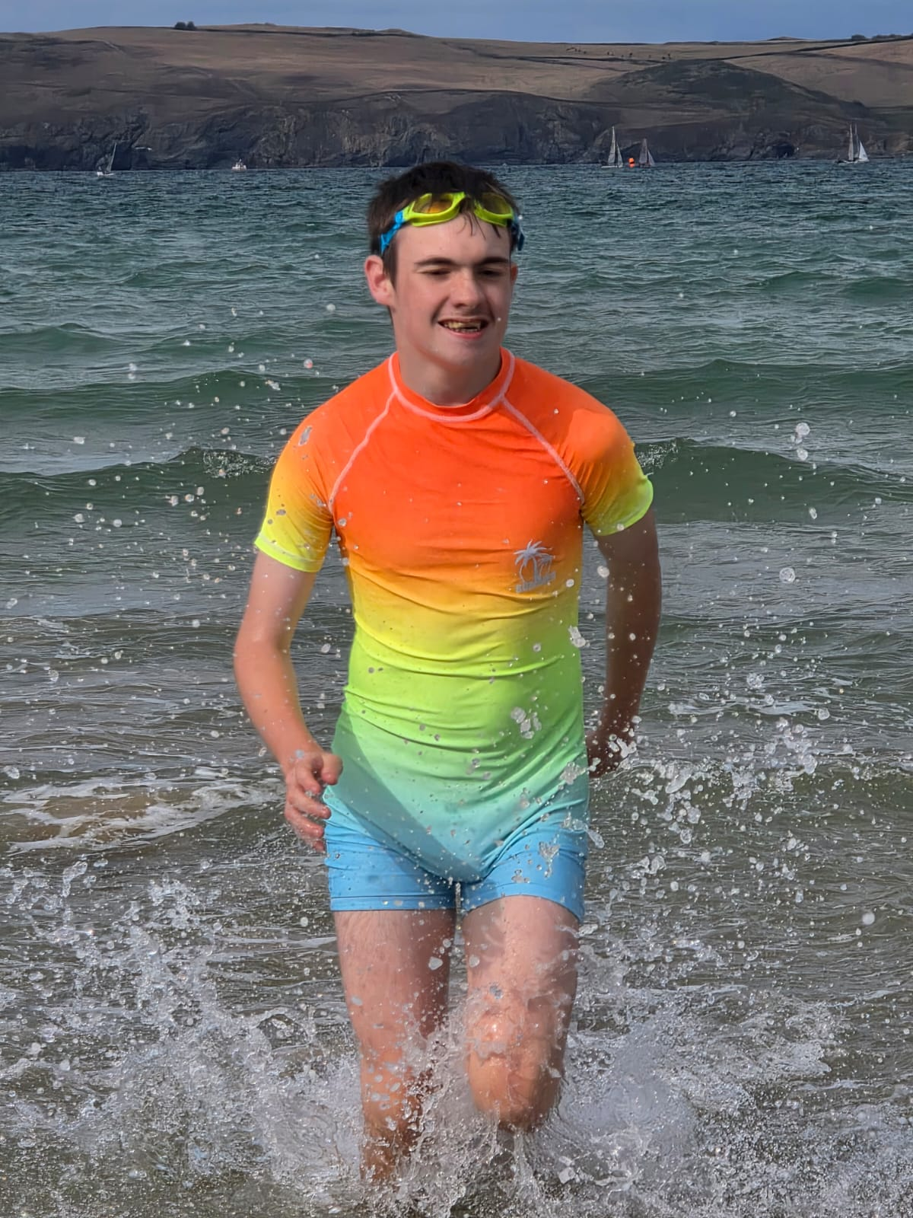

Slide 16
Thank you

